Slide 1
Biting Gold:
How to Test An Organization's Mettle with BDD
Or:
How to get through 50 slides in 10 minutes or less
That’s 5 slides per minute, or 1 slide every 12 seconds [on average]

Slide 2
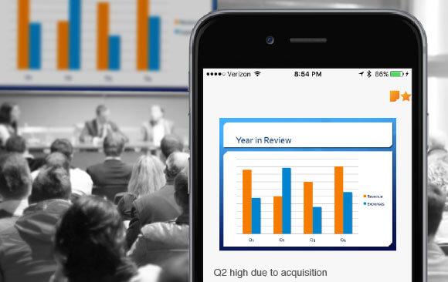
I WILL SHARE THE SLIDE DECK VIA THE MEETUP AFTER TONIGHT’S PRESENTATION

Slide 3
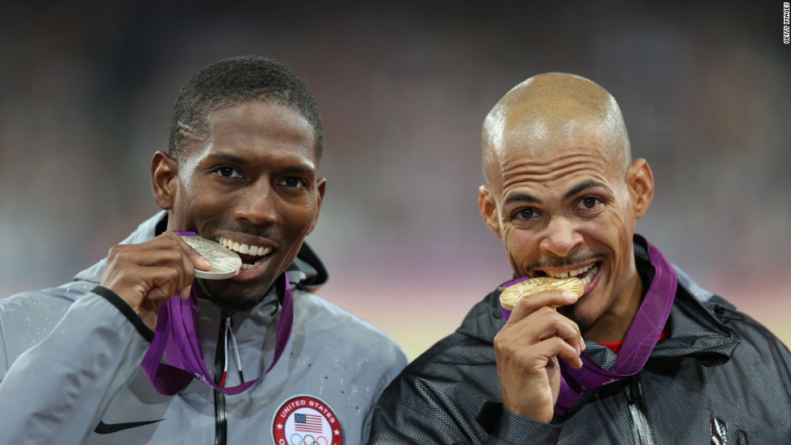
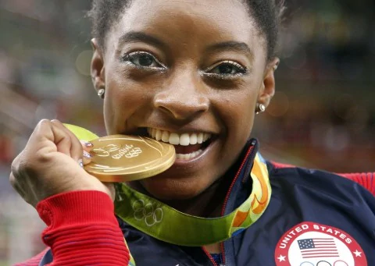
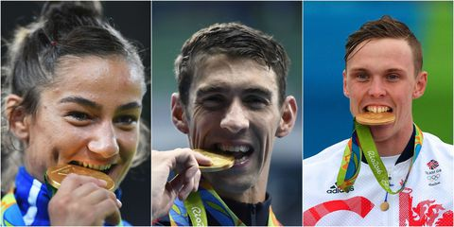
Yum!

Slide 4
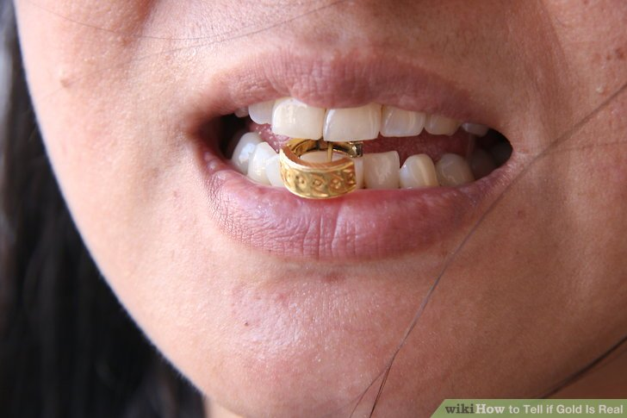
Interesting quality of gold:
Gold vs. tooth-- tooth wins!

Slide 5
Why is it so important to know if it is gold?
Value

Slide 6
Imagine you want to make a thing
Thing

Slide 7
Imagine you want to make a thing
the thing has “value”
Thing
5000?

Slide 8
Imagine you want to make a thing
after testing, the thing has value!
Thing
tested
5000!

Slide 9
Now, a project I’m working on: RestfulTestful
5000?
Automatically feed faked API results to Unit tests from a database a non technical user can populate-- along with expected results

Slide 10
Is it atomic?
5000?
Automatically feed faked API results to Unit tests from a database a non technical user can populate-- along with expected results

Slide 11
Is it atomic? No
5000?
Automatically feed faked API results to Unit tests from a database a non technical user can populate-- along with expected results
2500?
2500?
Build faked API database
Feed faked API database to unit tests and respond accordingly

Slide 12
Are they atomic?
2500?
2500?
Build faked API database
Feed faked API database to unit tests and respond accordingly

Slide 13
Are they atomic? No
2500?
2500?
Build faked API database
Feed faked API database to unit tests and respond accordingly
Present front end for case entry
Commit cases to database
For a given unit test, get its test case API values and expected result
Compare expected result with actual result and feed to PyBrace!
1250?
1250?
1250?
1250?

Slide 14
Eventually, yes, even your entire organization is this
5000?
Organization
2500?
2500?
Product/Service
Product/Service

Slide 15
Getting to value with PyJamb
5000?
2500?
2500?
1250?
1250?
600?
1900?
250?
1000?
250?
1000?
200?
400?
250?
1650?

Slide 16

PyJamb

Slide 17
PyJamb helps the team design value iteratively
5000?

Slide 18
PyJamb helps the team design value iteratively
5000?
2500?

Slide 19
PyJamb helps the team design value iteratively
5000?
2500?
2500?

Slide 20
PyJamb helps the team design value iteratively
5000?
2500?
2500?
1250?

Slide 21
PyJamb helps the team design value iteratively
5000?
2500?
2500?
1250?
1250?

Slide 22
PyJamb helps the team design value iteratively
5000?
2500?
2500?
1250?
1250?
600?

Slide 23
PyJamb helps the team design value iteratively
5000?
2500?
2500?
1250?
1250?
600?
1900?

Slide 24
PyJamb helps the team design value iteratively
5000?
2500?
2500?
1250?
1250?
600?
1900?
250?

Slide 25
PyJamb helps the team design value iteratively
5000?
2500?
2500?
1250?
1250?
600?
1900?
250?
1000?

Slide 26
PyJamb helps the team design value iteratively
5000?
2500?
2500?
1250?
1250?
600?
1900?
250?
1000?
250?

Slide 27
PyJamb helps the team design value iteratively
5000?
2500?
2500?
1250?
1250?
600?
1900?
250?
1000?
250?
1000?

Slide 28
PyJamb helps the team design value iteratively
5000?
2500?
2500?
1250?
1250?
600?
1900?
250?
1000?
250?
1000?
200?

Slide 29
PyJamb helps the team design value iteratively
5000?
2500?
2500?
1250?
1250?
600?
1900?
250?
1000?
250?
1000?
200?
400?

Slide 30
PyJamb helps the team design value iteratively
5000?
2500?
2500?
1250?
1250?
600?
1900?
250?
1000?
250?
1000?
200?
400?
250?

Slide 31
PyJamb helps the team design value iteratively
5000?
2500?
2500?
1250?
1250?
600?
1900?
250?
1000?
250?
1000?
200?
400?
250?
1650?

Slide 32
PyJamb hooks overall value design to unit tests
5000?
2500?
2500?
1250?
1250?
600?
1900?
250?
1000?
250?
1000?
200?
400?
250?
1650?

Slide 33
Failed tests in PyJamb do not count as value
5000?
2500?
2500?
1250?
1250?
600?
1900?
250?
1000?
250?
1000?
200?
400?
250?
1650?

Slide 34
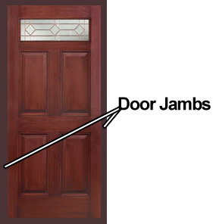
PyJamb

Slide 35
Passed tests in PyJamb count as value
5000?
2500?
2500?
1250?
1250?
600?
1900?
250!
1000?
250?
1000?
200?
400?
250?
1650?

Slide 36
Passed tests in PyJamb count as value
5000?
2500?
2500?
1250!
1250?
600?
1900?
250!
1000!
250?
1000?
200?
400?
250?
1650?

Slide 37
Passed tests in PyJamb count as value
5000?
2500?
2500?
1250!
1250?
600?
1900?
250!
1000!
250!
1000?
200?
400?
250?
1650?

Slide 38
Passed tests in PyJamb count as value
5000?
2500!
2500?
1250!
1250!
600?
1900?
250!
1000!
250!
1000!
200?
400?
250?
1650?

Slide 39
Passed tests in PyJamb count as value
5000?
2500!
2500?
1250!
1250!
600?
1900?
250!
1000!
250!
1000!
200!
400?
250?
1650?

Slide 40
Passed tests in PyJamb count as value
5000?
2500!
2500?
1250!
1250!
600!
1900?
250!
1000!
250!
1000!
200!
400!
250?
1650?

Slide 41
Passed tests in PyJamb count as value
5000?
2500!
2500?
1250!
1250!
600!
1900?
250!
1000!
250!
1000!
200!
400!
250!
1650?

Slide 42
Passed tests in PyJamb count as value
5000!
2500!
2500!
1250!
1250!
600!
1900!
250!
1000!
250!
1000!
200!
400!
250!
1650!

Slide 43
PyJamb reporting and side effects
Supports BDD because the entire team is involved in creating the value hierarchy, representing it in human language

Slide 44
PyJamb reporting and side effects
First order documentation is written as the team builds the value hierarchy

Slide 45
PyJamb reporting and side effects
Can provide documentation all the way up from a test case to the application, project, organization level-- meaning that there is traceability up and down the value hierarchy

Slide 46
PyJamb reporting and side effects
Can provide visual instrumentation of the health of your application, project, organization-- all based on the latest unit test results

Slide 47
PyJamb reporting and side effects
Can provide a prioritized to do list of items which need to be tested with passing results to unlock the most value

Slide 48
PyJamb reporting and side effects
Can enforce red, green, refactor TDD by telling you red tests which need to be resolved before suggesting new features to create tests for

Slide 49

PyJamb shows there is no value without testing!

Slide 50
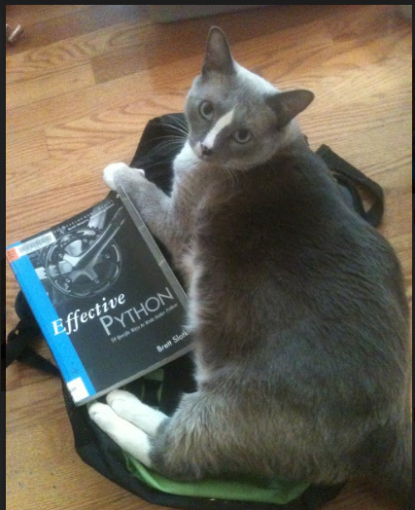
Erik Pohl
erik.pohl.444@gmail.com
iotasubscript@gmail.com
Linked In: https://www.linkedin.com/in/erik-pohl-0792159/
GitHub: https://github.com/ErikPohl-Lot49-Projects/Erik-Pohl-Repo/
My cat, Fritz, who helped a little with this slide deck.

